Slide 1
MUNNALURI S N S BHAVANI PRASAD
Final Project

Slide 2
PROJECT TITLE
KEYLOGGER AND SECURITY

Slide 3


AGENDA
What is keylogging?
Can a keylogger can be detected?
How to protect my devices from keylogging?
Examples of a keylogger
Steps to create a keylogger
Hardware keyloggers
Software keyloggers
How to defend keyloggers?
Advantages and disadvantages of keylogging
Conclusion
3/21/2024 Annual Review

Slide 4
What is keylogging?
A keylogger can be special hardware or software that can record keystrokes as you type on a keyboard. You will be able to see passwords and usernames to various accounts (i.e bank accounts, email, etc), google searches, conversations that can be used to extort money or more information from a target, etc. Cybercriminals create fake websites or send an email embedding the keylogger in a malicious link or in a downloadable attachment known as a phishing attack. Everyone should be aware of what a keylogger is and how to protect yourself or your business organization against one.

Slide 5
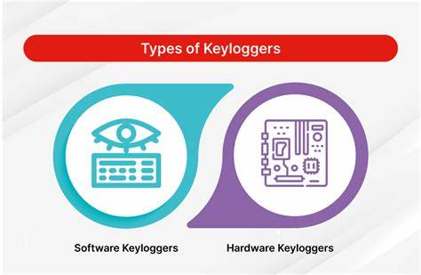

Slide 6
Can a keylogger can be detected?
keyloggers can be detected, but the method depends on the type of keylogger:
Keylogger Types: Hardware vs Software-based
Hardware-based Keyloggers
A hardware-based keylogger is a tiny device, a physical component that connects to the computer via the keyboard. The device usually looks like a standard keyboard PS/2 connector, computer cabling, or a USB adaptor, making it relatively simple to conceal the device for someone who wants to keep an eye on a user’s behavior.

Slide 7
Hardware keyloggers
These are the easiest to detect by physically inspecting the keyboard circuitry, USB and PS/2 ports, and any hardware additions to the computer. However, they can be dangerous because they can't be detected by security software and can't be installed remotely.
Software-based Keyloggers
A software-based keylogger is a computer program that can be installed without having direct access to the user’s computer. It can be downloaded on purpose by someone who wants to monitor a computer, or it can be downloaded without the user’s knowledge and run as part of a rootkit or a remote administration Trojan (RAT).

Slide 8
Software keyloggers
These can be more difficult to detect, especially those with rootkit functionality. However, they can sometimes reveal themselves through warning signs, such as: System slowdown
Unusual mouse or keyboard behavior
Unexpected changes in browser performance
Unexplained network activity
Unfamiliar processes in the Task Manager
Abnormal delays in activity
Pop-ups

Slide 9
New icons on your desktop or system tray
Excessive hard drive or network activity
A slow browser
A lag in mouse movements and keystrokes
A disappearing cursor

Slide 10

PROBLEM STATEMENT
Keyloggers are a genuine danger to clients and the clients' information, which is considered exploitative movement. The problem statement is that the keyloggers can be detected using antiviruses. Installation of hardware keyloggers is difficult without the knowledge of the owner of the system. The solution to the above existing problem is that we can build a software keyloggers instead of hardware keyloggers.

Slide 11

PROJECT OVERVIEW
A keylogger is a program that captures and records keystrokes on a keyboard. Keyloggers can be used for both legitimate and illegitimate purposes, such as identifying fraudulent users, helping computer forensics analysts, and tracking criminal activity.
Here are some keylogger project ideas:
Track keystrokes
A keylogger can track keystrokes and send them to an admin's email address without the user's knowledge.
Store in a database
A keylogger can record user activities and store the results in a database that only the keylogger owner can access.
Gather other information
A keylogger can also gather other computer information, such as network information, clipboard content, and microphone recordings. It can also take screenshots of the computer screen.
3/21/2024 Annual Review

Slide 12

WHO ARE THE END USERS?
Keyloggers are software that can be used for both legitimate and criminal purposes. Some legitimate uses include:
Employee monitoring
Companies can use keyloggers to track employee productivity and monitor their activities.
IT troubleshooting
Keyloggers can help IT professionals collect information about user issues to resolve them.
Computer product development
Keyloggers can help companies gather user feedback to improve their products.
Business server monitoring
Keyloggers can help companies monitor web servers for unauthorized activity.
However, keyloggers can also be used for criminal purposes, such as spying on a partner or stealing sensitive information like passwords and credit card numbers. If a malicious keylogger falls into the wrong hands, it can lead to identity theft, financial loss, and other serious consequences

Slide 13

YOUR SOLUTION AND ITS VALUE PROPOSITION
Keyloggers are surveillance technology that can record a device's activity and send it to a controlling entity. They can be hardware devices or software, and can be installed on a computer or smartphone. Keyloggers can be difficult to detect because they are designed to be silent and invisible. Here are some ways to protect against keyloggers:
Use security software
Install reputable antivirus and anti-malware software that can help detect and prevent keyloggers. Keep the software up to date to patch vulnerabilities that attackers might exploit.
Use multifactor authentication
This adds an extra step to logging into an account or device, requiring a temporary PIN or fingerprint to verify your identity. This can prevent cybercriminals from accessing your accounts remotely, even if your password is compromised.

Slide 14
Use virtual keyboards
For security-sensitive activities like entering passwords, you can use a virtual keyboard to thwart keyloggers that capture physical keystrokes.
Be skeptical
Be wary of any attachments you receive, and only download files from safe websites. Don't click links in emails from unknown senders.
Update your system
Regularly update your operating system, applications, and web browsers to patch vulnerabilities.
Use a firewall
A firewall can help monitor network traffic for suspicious activity. It can also provide strong authentication controls and help protect your data with encryption and access permissions.
To protect yourself from keyloggers:
Use Security Software:
Install reputable antivirus and anti-malware software that can help detect and prevent keyloggers. ...
Keep Software Updated:
Regularly update your operating system, applications, and security software to patch vulnerabilities that attackers might exploit.

Slide 15

THE WOW IN YOUR SOLUTION
Solutions to this problem can be multifaceted, combining hardware, software, and procedural measures. Here's a breakdown of some innovative and effective aspects of solutions to keylogging:
1. Anti-Keylogging Software
Encryption-Based Keyboards: Some anti-keylogging software encrypts keystrokes at the keyboard level. This means that even if a keylogger captures the data, it will only see encrypted gibberish instead of useful information.
Keystroke Randomization: This method inserts random characters into keystroke data, which can only be deciphered by the intended application, making the data useless to a keylogger.
Behavior Analysis: Modern anti-malware solutions often include behavior analysis to detect suspicious activities related to keylogging, such as unusual patterns in keystroke capturing..
3/21/2024 Annual Review
15

Slide 16
2. Hardware Solutions Secure Keyboards: These keyboards have built-in encryption to ensure that any data leaving the keyboard is encrypted, making it significantly harder for keyloggers to intercept and decipher the information. External Key Encryption Devices: These devices sit between the keyboard and the computer, encrypting all keystrokes before they reach the computer. 3. Multi-Factor Authentication (MFA) Even if a keylogger captures a password, MFA requires a second form of authentication (such as a text message, email, or authentication app), making it much harder for keyloggers to provide the second piece of information needed for access. 4. Virtual Keyboards and On-Screen Keyboards Virtual Keyboards: Using a virtual keyboard to enter sensitive information can thwart keyloggers since they cannot capture clicks on the on-screen keyboard. Dynamic On-Screen Keyboards: These keyboards change the layout of keys randomly to further complicate any attempt by a keylogger to record meaningful data.

Slide 17
5. Security Best Practices
Regular Updates and Patches: Ensuring that operating systems and all software are up to date to protect against vulnerabilities that keyloggers might exploit.
User Education: Training users to recognize phishing attempts and other social engineering techniques that are often used to install keyloggers.
6. Behavioral Biometrics
This approach analyzes patterns in the way users type and interact with their devices. If the system detects behavior that doesn’t match the user’s typical patterns, it can flag the activity for further investigation.
Combining these methods can create a robust defense against keylogging. The "wow" factor often comes from innovative approaches like encryption-based keyboards, dynamic on-screen keyboards, and behavioral biometrics, which add layers of security beyond traditional methods.

Slide 18
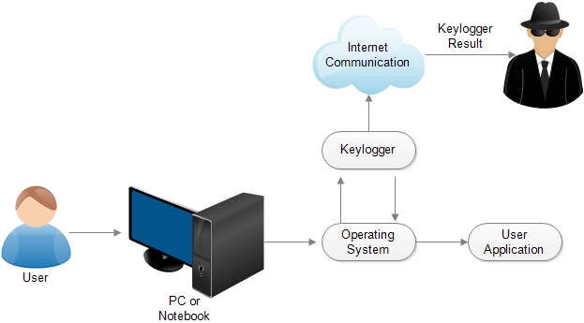
MODELLING
Teams can add wireframes
18

Slide 19
RESULTS
Keyloggers are a potent threat to both individuals and enterprises, with the potential to cause significant harm if left undetected.
Once a keylogger has access to this information, it can be used for identity theft, financial fraud, and other cybercrimes. For example, cybercriminals can use a victim's passwords to impersonate them on social media or send messages to their contacts as part of a phishing scam.
Some signs that a device may have a keylogger include:
Slow web browsing performance
Lag in mouse movement or keystrokes
What's typed doesn't appear on the screen
Error messages when loading web pages or graphics
To protect against keyloggers, you can use trusted antivirus software.
Code link -https://github.com/surya-munnaluri/munnaluri-s-n-s-bhavani-prasad-project.git
19

